Slide 1
PANIMALAR INSTITUTE OF TECHNOLOGY-CHENNAI-600123 IOT Industry Protection Using Arduino
INDURU BHARATH KUMAR REDDY-211517106043
DORNADULA LOHITH-211517106028
KAIPU VINOD KUMAR REDDY-211517106056
GUIDE-Mrs.V.JEYARAMYA

Slide 2
ABSTRACT
Today, smart grid, smart homes, smart water networks, intelligent transportation, are infrastructure systems that connect our world more than we ever thought possible.
The common vision of such systems is usually associated with one single concept, the Internet of Things (IoT), where through the use of sensors, the entire physical infrastructure is closely coupled with information and communication technologies; where intelligent monitoring and management can be achieved via the usage of networked embedded devices.
These devices will connect to internet to share different types of data.
We have proposed an Industrial Monitoring System using WIFI module and sensing based applications for internet of things.

Slide 3
INTRODUCTION
Now- a – days, the industrial monitoring field requires more manual power to monitor and control the industrial parameters such as temperature, humidity, gas etc. this is the most upcoming issues in the industrial sectors. if the parameters are not monitored and control properly, it leads to a harmful situation.
Most of the industries are facing those kinds of situation because of some manual mistakes. To overcome manual mistakes we are using industrial automation with internet of things. WIRELESS SENSOR NETWORKS (WSN) has been employed to collect data about physical phenomena in various applications such as habitat monitoring, and ocean monitoring, and surveillance.
As an emerging technology brought about rapid advances in modern wireless telecommunication, Internet of Things (IoT) has attracted a lot of attention and is expected to bring benefits to numerous application areas including industrial WSN systems, and healthcare systems manufacturing.

Slide 4
LITERATURE SURVEY
S.NO | Journal Type With Year | Authors | Title
1 | IEEE Electric Ship Technologies Symposium (ESTS),2013 | Braham Barkat, Majid Poshtan | Smart electrical protection method for industries operations
2 | 52nd ACM/EDAC/IEEE Design Auomation Conference (DAC),2015 | Christian Wachsmann, Michael waidner | Security And Privacy Challenges In Industrail Internet Of Things
3 | IEEE/PES Tranmission And Distribution Conference And Exhibition | Prateeksha U Shanbhag, Pragathi Hegde | Survey on IOT Industry Protection System Using Arduino

Slide 5
EXISTING SYSTEM
1. Implementation of ZigBee-GSM based home security monitoring and remote control system
Arbab Waheed Ahmad , Naeem Jan, Saeed Iqbal and Chankil Lee proposed Implementation of ZigBeeGSM based Home Security Monitoring and Remote Control system. Home security and control is one among the essential needs of mankind from youth. But today it's to be updated with the rapidly changing technology to make sure vast coverage, remote, reliability, and real time operation. Deploying wireless technologies for security and control in home automation systems offers attractive benefits along side user friendly interface

Slide 6
INDUSTRY BASED SECURITY SYSTEM USING GSM AND ARDUINO(Shubham Raut, Avinash Gaikwad , Mudaliyar Raghurajan , Pratiksha Patil)
This paper describes the design of a simple low cost GSM based security monitoring system using GSM technique. The security monitoring system using GSM undergoes analog to digital converter and with GSM Modem the message is send to mobile. ADC is used because Arduino works with digital inputs. GSM modem can be used at the transmitter side, the user sends an SMS to the GSM modem using.

Slide 7
PROPOSED SYSTEM
In this system,we implement IOT based Industrial protection system using Arduino UNO.
The system makes use of arduino to achieve this functionality. The system makes use of temperature sensing along with light ans gas sensing to detect fire, gas leakage as well as low lighting to avoid any industrial accidents and prevent losses.
The system consists of light, gas and temperature sensors interfaced with arduino and LCD screen. The sensor data is constantly scanned to record values andcheck for fire, gas leakage or low light and then this data is transmitted online.
The wifi module is used to achieve internet functionality.
The sensor data is displayed on the webpage

Slide 8
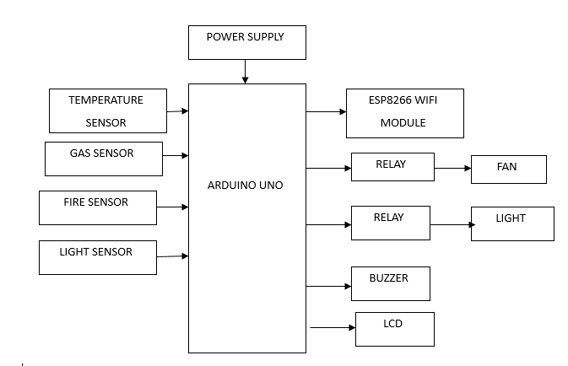
BLOCK DIAGRAM

Slide 9
HARDWARE REQUIREMENTS
Arduino Uno
LCD Display
Wifi Module
LDR Sensor
Gas Sensor
Temperature Sensor
RELAY
POWER SUPPLY

Slide 10
AURDINO CONTROLLER
The Arduino Uno is a microcontroller board based on the ATmega328. It has 14 digital input/output pins (of which 6 can be used as PWM outputs), 6 analog inputs, a 16 MHz ceramic resonator, a USB connection, a power jack, an ICSP header, and a reset button.
It contains everything needed to support the microcontroller; simply connect it to a computer with a USB cable or power it with a AC-to-DC adapter or battery to get started.
The Uno differs from all preceding boards in that it does not use the FTDI USB-to-serial driver chip. Instead, it features the Atmega16U2 (Atmega8U2 up to version R2) programmed as a USB-to-serial converter

Slide 11
SPECIFICATIONS
Microcontroller : ATmega328
Operating Voltage: 5V
Input Voltage (recommended): 7-12V
Input Voltage (limits): 6-20V
Digital I/O Pins : 14 (of which 6 provide PWM output)
Analog Input Pins : 6
DC Current per I/O Pin :40 mA
DC Current for 3.3V Pin :50 mA
Flash Memory 32 KB (ATmega328) of which 0.5 KB used by bootloader
SRAM 2 KB (ATmega328)
EEPROM 1 KB (ATmega328)
Clock Speed 16 MHz

Slide 12
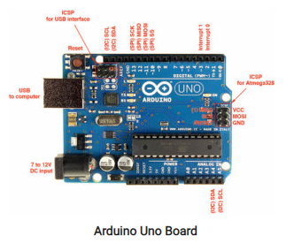

Slide 13
LCD
A liquid crystal display (LCD) is a thin, flat display device made up of any number of color or monochrome pixels arrayed in front of a light source or reflector.
Each pixel consists of a column of liquid crystal molecules suspended between two transparent electrodes, and two polarizing filters, the axes of polarity of which are perpendicular to each other. Without the liquid crystals between them, light passing through one would be blocked by the other.
The liquid crystal twists the polarization of light entering one filter to allow it to pass through the other.
A program must interact with the outside world using input and output devices that communicate directly with a human being. One of the most common devices attached to an controller is an LCD display.

Slide 14
FEATURES:
Interface with either 4-bit or 8-bit microprocessor.  
(2) Display data RAM
(3) 80x 8 bits (80 characters).  
(4) Character generator ROM
(5). 160 different 5   7 dot-matrix character patterns.
(6).  Character generator RAM
(7)  8 different user programmed 5   7 dot-matrix patterns.
(8).Display data RAM and character generator RAM may be Accessed by the microprocessor

Slide 15
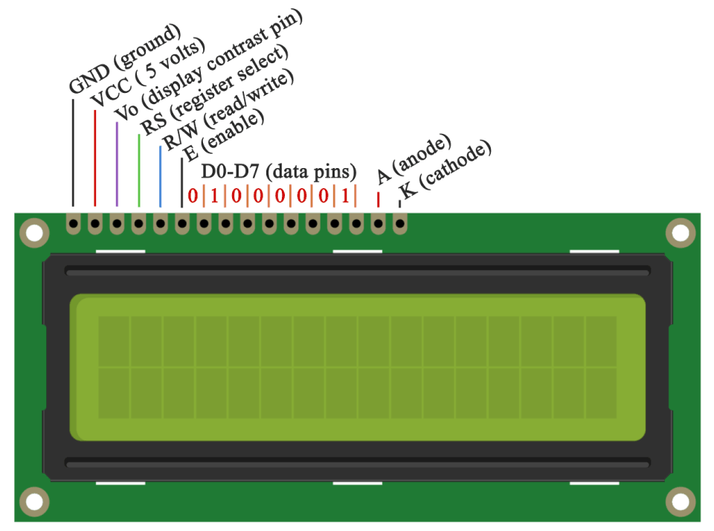
PIN DESCRIPTION

Slide 16
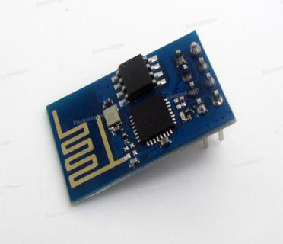
WIFI MODULE
ESP-12E WiFi module is developed by Aithinker Team. core processor ESP8266 in smaller sizes of the module encapsulates Tensilica L106 integrates industry-leading ultra low power 32-bit MCU micro, with the 16-bit short mode, Clock speed support 80 MHz, 160 MHz, supports the RTOS, integrated Wi-Fi MAC/BB/RF/PA/LNA, on-board antenna.
ESP8266 is high integration wireless SOCs, designed for space and power constrained mobile platform designers.

Slide 17
TEMPERATURE SENSOR
The LM35 series are precision integrated-circuit temperature sensors, whose output voltage is linearly proportional to the Celsius (Centigrade) temperature.
The LM35 thus has an advantage over linear temperature sensors calibrated in ˚ Kelvin, as the user is not required to subtract a large constant voltage from its output to obtain convenient Centi- grade scaling.

Slide 18
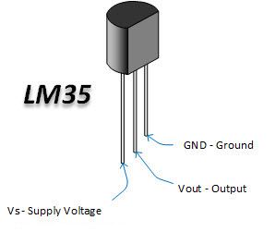
FEATURES
Calibrated directly in ˚ Celsius (Centigrade)
Linear + 10.0 mV/˚C scale factor
0.5˚C accuracy guaranteeable (at +25˚C)
Rated for full −55˚ to +150˚C range
Suitable for remote applications
Low cost due to wafer-level trimming
Operates from 4 to 30 volts
Less than 60 µA current drain
Low self-heating, 0.08˚C in still air
Nonlinearity only ±1⁄4˚C typical
Low impedance output, 0.1for 1 mA load

Slide 19
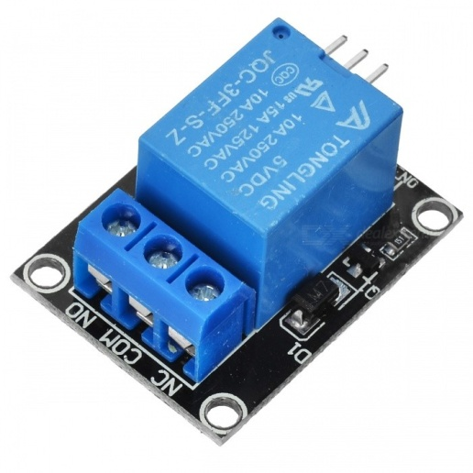
RELAY
A relay is an electrical switch that opens and closes under the control of another electrical circuit.
In the original form, the switch is operated by an electromagnet to open or close one or many sets of contacts.
A relay is able to control an output circuit of higher power than the input circuit, it can be considered to be, in a broad sense, a form of an electrical amplifier.

Slide 20

POWER SUPPLY
All digital circuits require regulated power supply. In this article we are going to learn how to get a regulated positive supply from the mains supply.

Slide 21
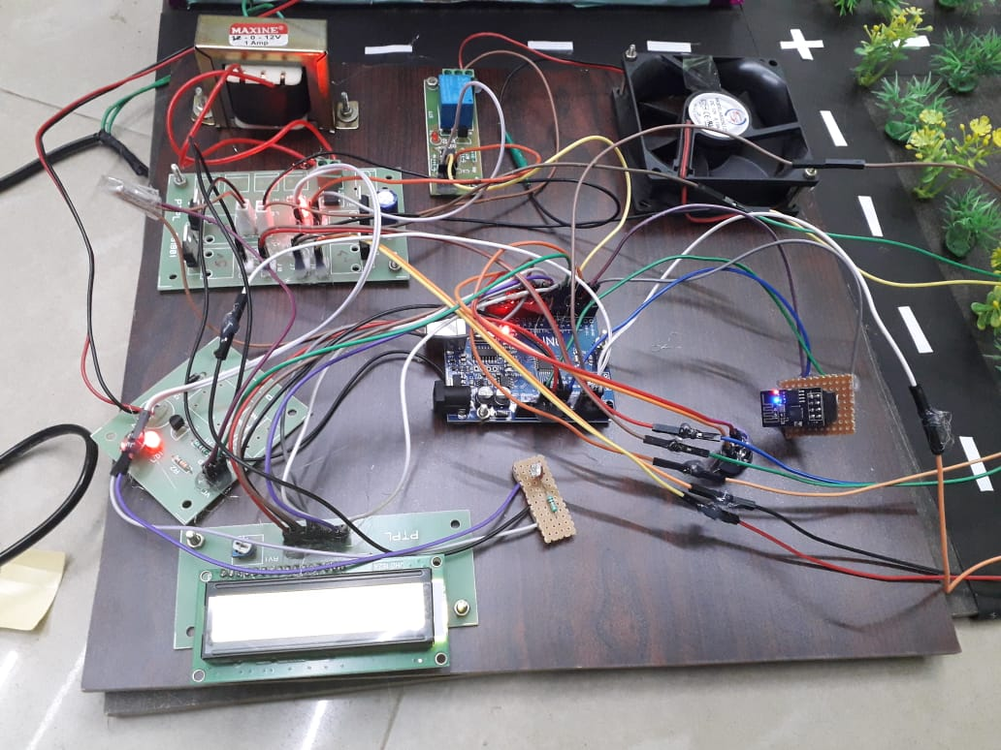

Slide 22
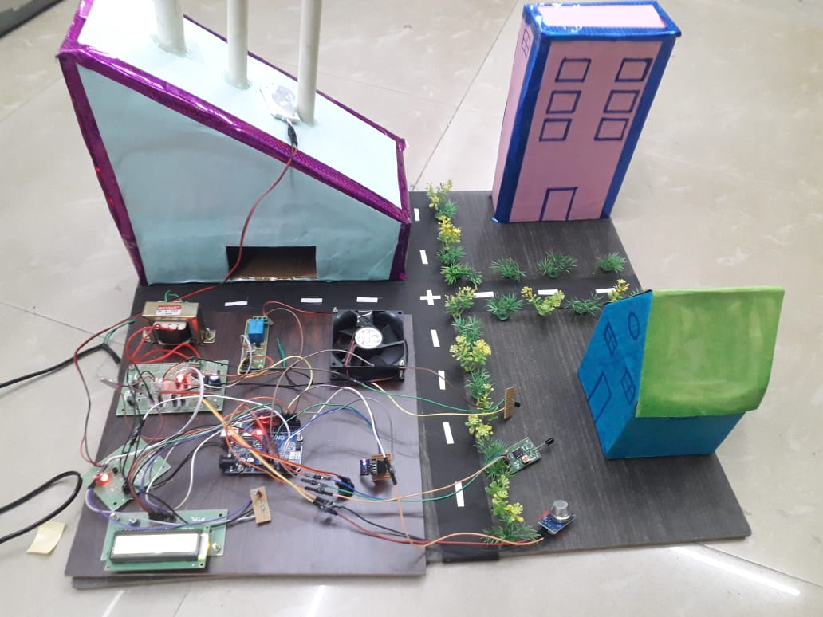

Slide 23
